Slide 1
Storage
Raid levels

Slide 2
RAID :
RAID used to stand for redundant array of inexpensive disks.
RAID is a way of grouping individual physical drives together to form one bigger drive called a RAID set.
Notes:
Usar para separador de capitulos . Seria bom ter esta versao em vermelho e verde tb..

Slide 3
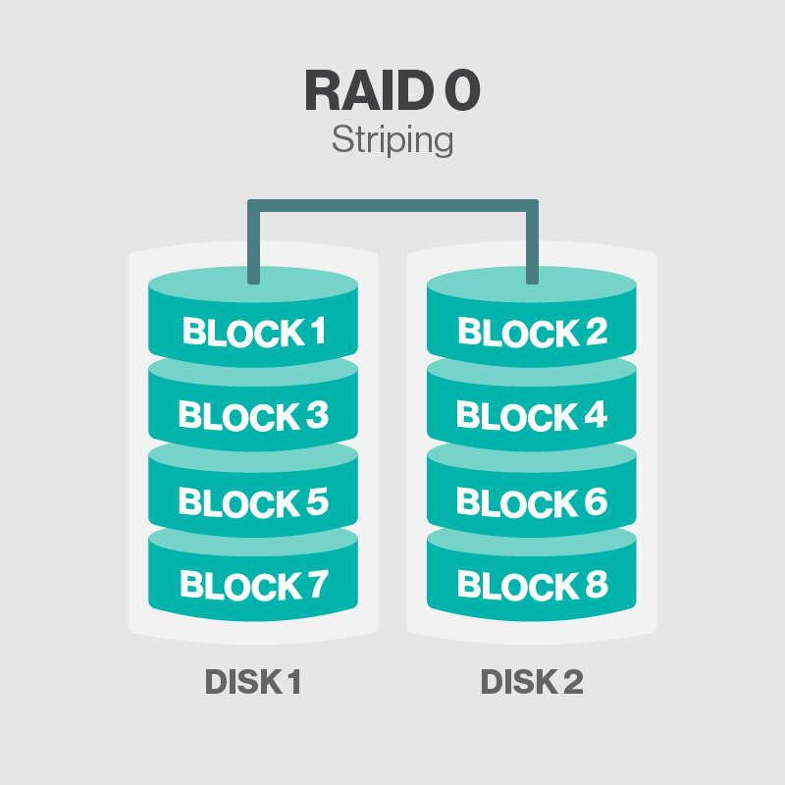
RAID 0
RAID 0 is called disk striping

Slide 4
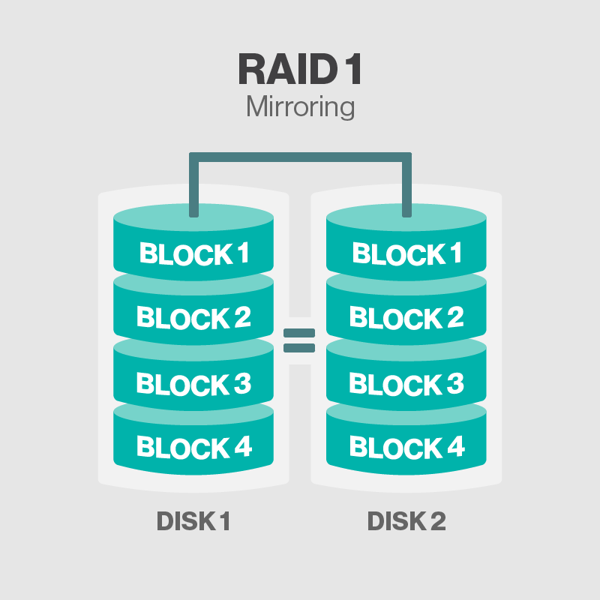
RAID 1
RAID 1 is also called disk mirroring

Slide 5
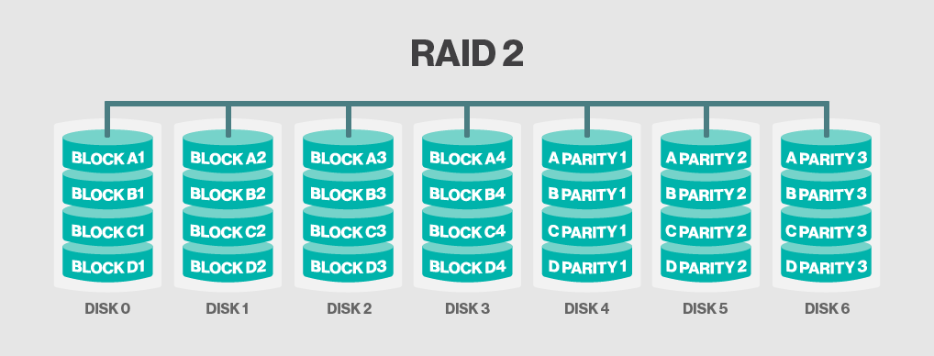
RAID 2
RAID 2 stripes data at the bit level using hamming code

Slide 8
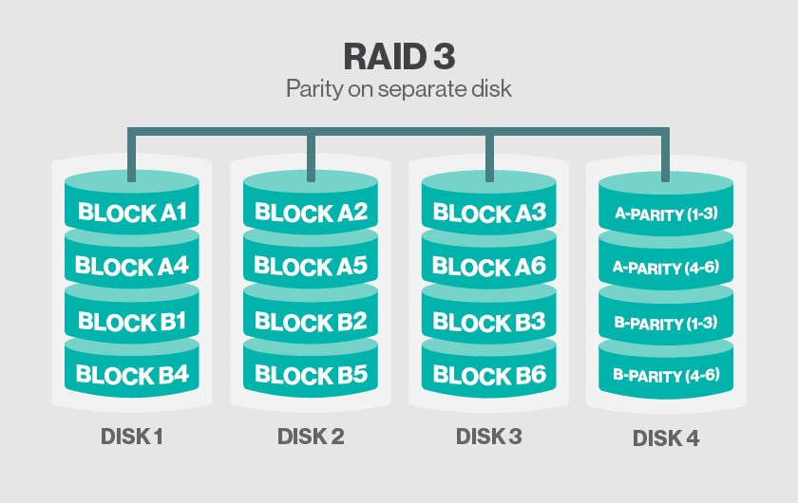
RAID 3
RAID 3 uses Parity on Separate Disk

Slide 9
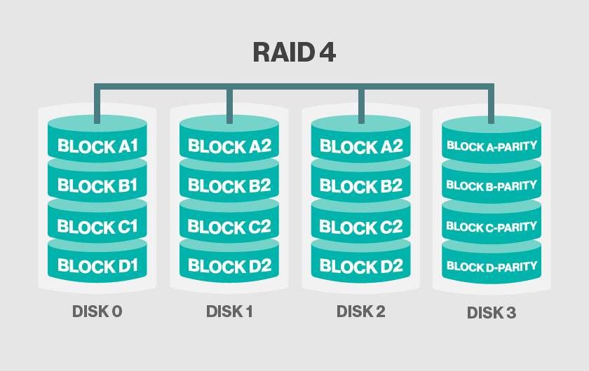
RAID 4
RAID 4 uses separate parity and block level Striping

Slide 10
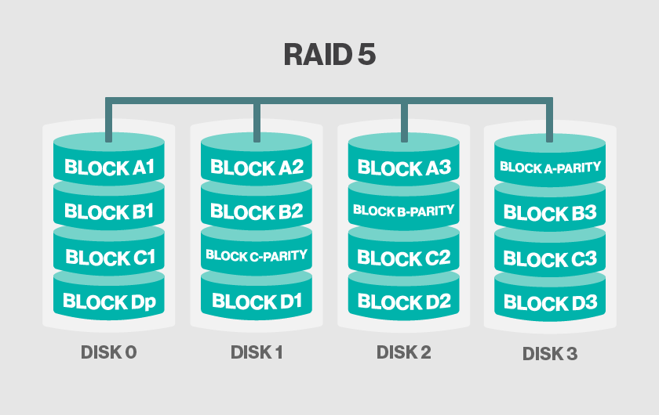
RAID 5
RAID 5 uses disk striping with parity

Slide 11
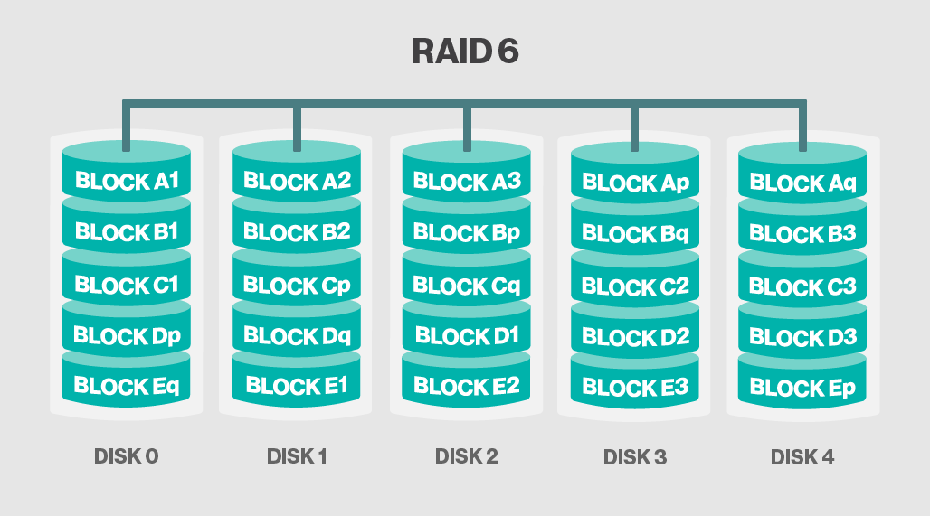
RAID 6
RAID 6 increases reliability by utilizing two parity stripes

Slide 12
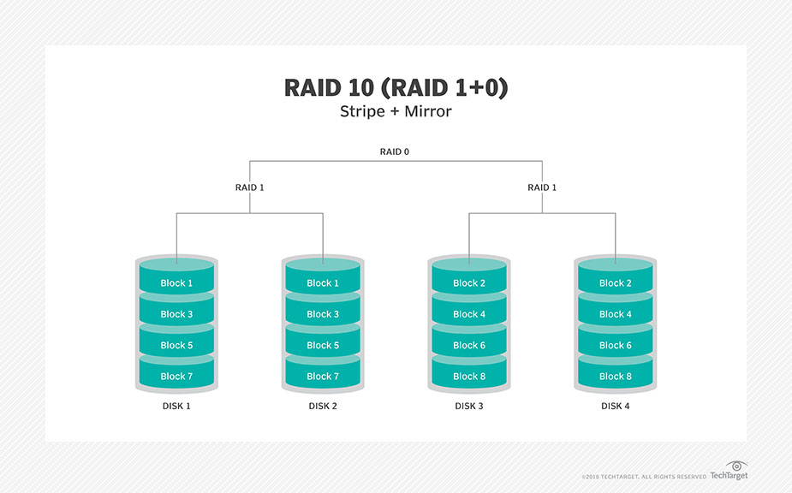
RAID 10
RAID 10 uses a combination of disk mirroring and disk Striping

Slide 13
Thank you
Notes:
EVITAR usar o spada branco – tem que ser sempre o colorido.

